Slide 1

ONTech Health Mobile: Daily Healthcare mobile application using LLaMA
Group 6: Cheng Li; Chenyu Ning

Slide 2
Introduction
Due to the lack of continuous health monitoring, personalized advice and understanding of medical conditions, maintaining a healthy lifestyle is a challenge for many people. Many health recommendations now do not provide specific guidance based on individual differences. For example, height, weight or blood pressure can affect lifestyle. This means a portable, user-friendly solution that provides real-time and personalized health guidance is needed.
By using LLM, LLaMA in particular, we want to offer an easy-to-use Android App that provides health advice based on individual needs, ONTech Health Mobile

Slide 3

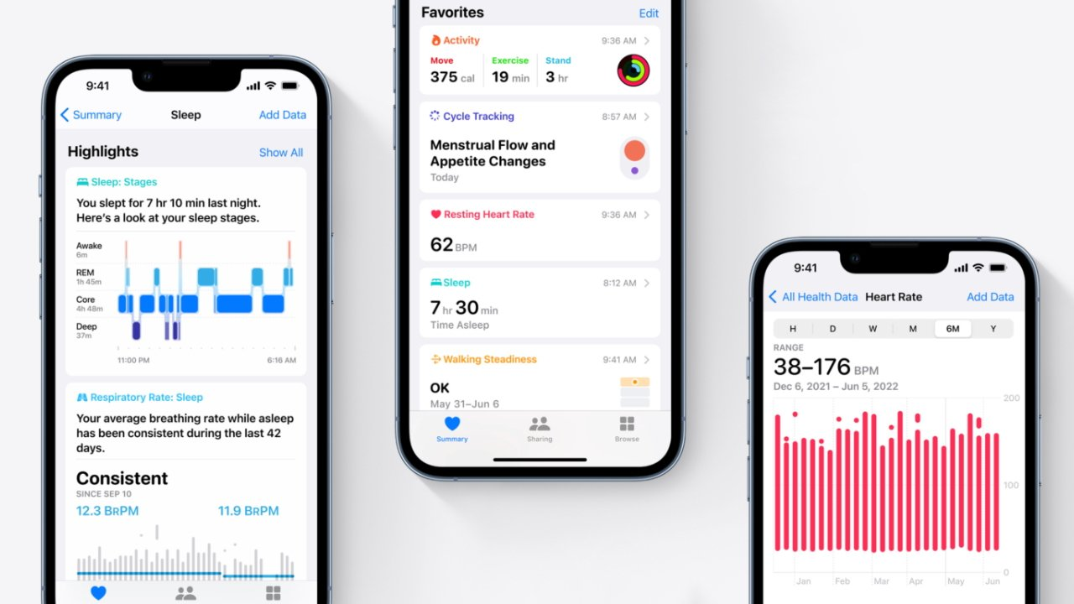
Background
Rising Demand for Fitness & Health Consultations:
Instant, personalized advice
Fitness goals, Dietary guidance,
Consult for unsure symptoms or minor health concerns.
Traditional Healthcare Services are facing:
Long waiting times
Inadequate follow-ups
General advice that doesn’t suit their unique needs
Digital health applications:
Static features like step tracking or calorie counting
Lack the intelligence needed to adapt to individual users

Slide 4
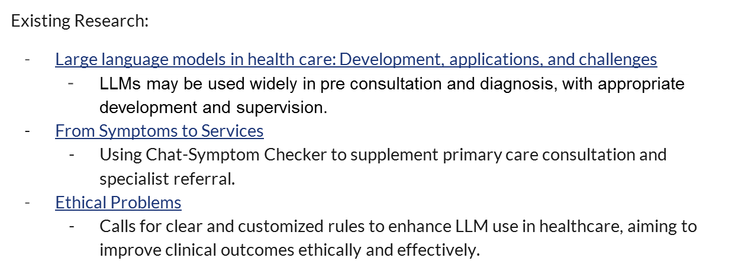
Literature Review

Slide 5
Motivation
We want to help users in three key ways:
Portability: It provides a portable solution that users can take with them, ensuring access to health advice anytime, anywhere
Personalization: It allows users to enter and store personal health information, enabling tailored recommendations
Disease Prevention: It promotes a healthier lifestyle by providing actionable recommendations related to diet, exercise, and overall health
Through a user-friendly Android interface, we will combine AI technology and daily health management to enable users to store and manage health data, get personalized recommendations and answers, and make informed decisions for healthier living

Slide 6
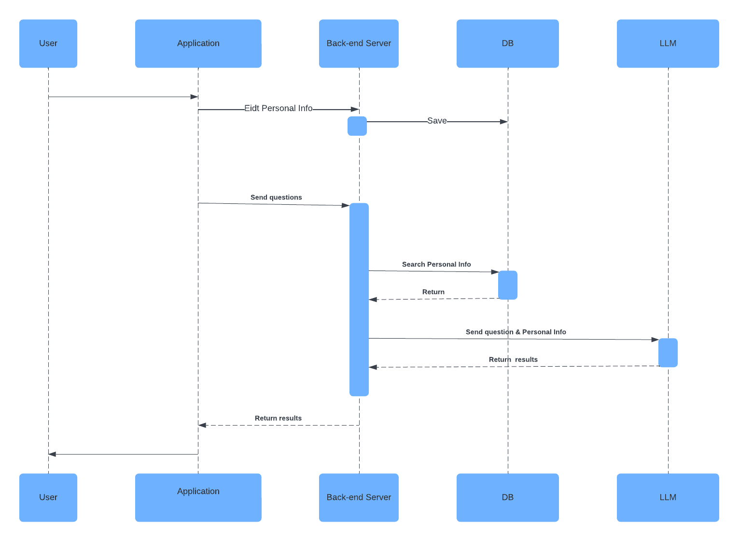
Architecture
& Tools
Tech Stacks:
Application ( Android & H5 )
Back-end ( Nodejs )
MongoDB
LLM ( LLama )
Tools:
Project Management: JIRA.
Version Control: GitHub.

Slide 7
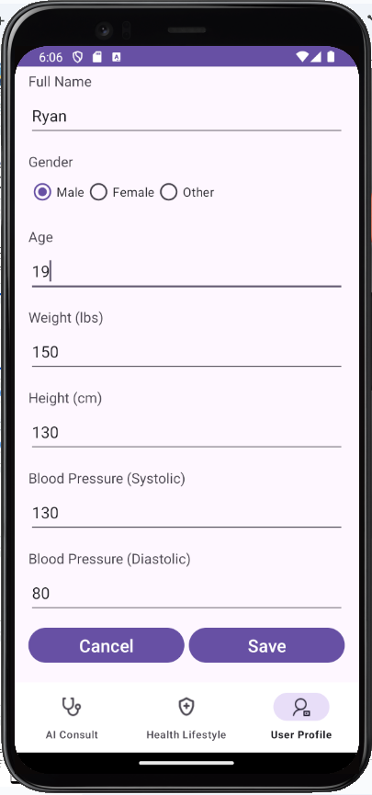
Methods - Android
In Android design, we mainly use a linear layout for the form-related pages, so that the page elements are arranged in a top-down order. And these pages provide two main buttons “Save” and “Cancel”, for submitting user data and resetting operations.
For the parts related to LLaMA, such as dialogue and health advice, we adopted a webview approach to hybrid development.
A BottomNavigationView is used as a navigation tool at the bottom of the interface, so users can quickly switch to different parts of the app, such as the home page, user profile or Settings page. Page switching is done by closing and creating a new activity.

Slide 8
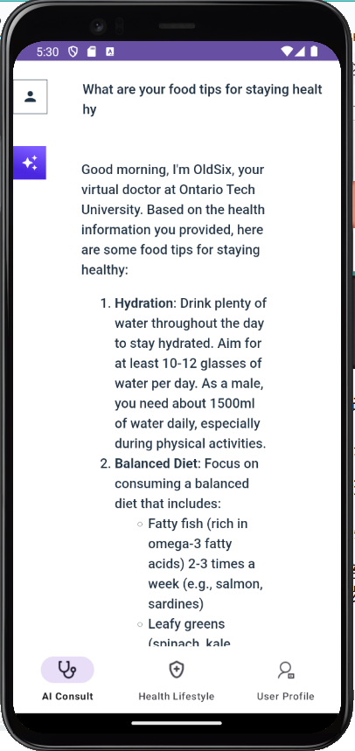
Methods - H5
Seamless Cross-Platform Deployment: The web-based components of a hybrid app can be easily reused or adapted for other platforms like web browsers or iOS apps, significantly reducing development effort and time.
Wearable Devices and IoT Compatibility: The lightweight and flexible nature of web technologies makes them suitable for adapting the conversation interface to wearable devices (e.g., smartwatches to get heart rate, sleep data ) or other IoT platforms.

Slide 9
Methods - Backend
Technology Stack: Koa2.js ( Node.js ). It’s lightweight and efficient for APIs
Functionalities:
Generate Prompt
  User questions and information are dynamically inserted into the prompt, enabling the model to generate personalized responses.
Model Integration
  Hugging Face Inference API: use model with a simple API request.
Real-Time Response Streaming
  Incremental response. This improves the user experience by delivering parts of the response in real-time rather than waiting for the entire output.

Slide 10
Methods
Database: MongoDB for efficient and scalable data storage.
APIs: RESTful APIs to ensure seamless communication between client and server.
CI/CD Pipeline: GitHub Actions for continuous integration and delivery.
Testing: Mocha for unit testing integrated within the CI pipeline.
Cloud Deployment: AWS powers reliable and scalable cloud-based deployment in the CD process.

Slide 11
Demo

Slide 12
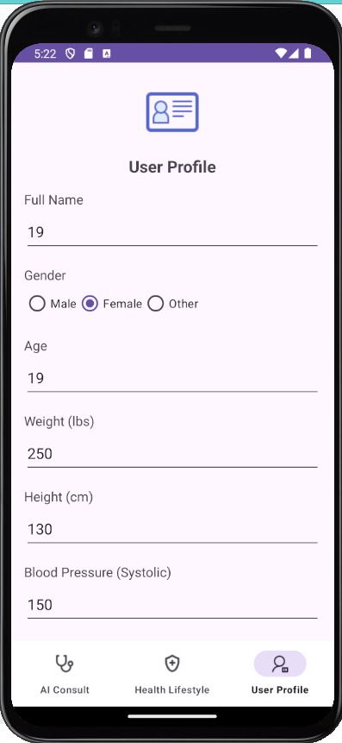
Testing
To evaluate the functionality and effectiveness of ONTech Health Mobile, we ran some simple manual tests on three key features: data entry and storage, life advice, and QA module.
First, for data entry and storage, we updated the user profile 20 times with details such as name, gender, age, blood pressure, weight, and height. In all cases, the system successfully stored the data without loss or corruption

Slide 13
Testing
For the AI Consult function, we tested 20 user queries. The questions raised by users range from general to individual. For example
“What are your food tips for staying healthy?”
“With my current health condition, is it safe to exercise?”
“Someone with suspected food poisoning, please provide some emergency assistance before the ambulance arrives”.
In most of the test scenarios, the system provided an appropriate answer based on the information stored by the user and the question. However, in a small number of cases where the user's question involves a drug or requires an answer from a medical professional, the LLM will refuse to answer the question.

Slide 14
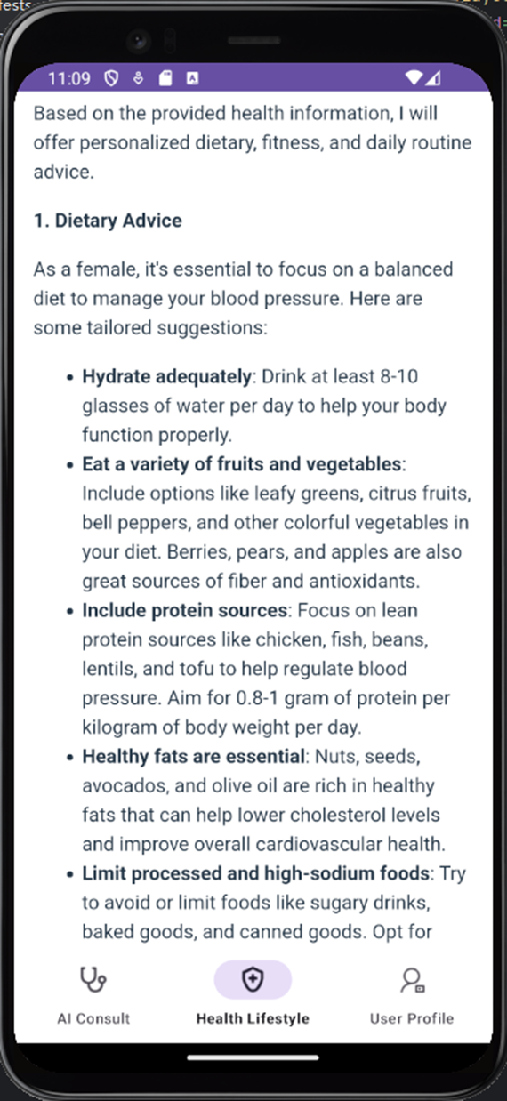
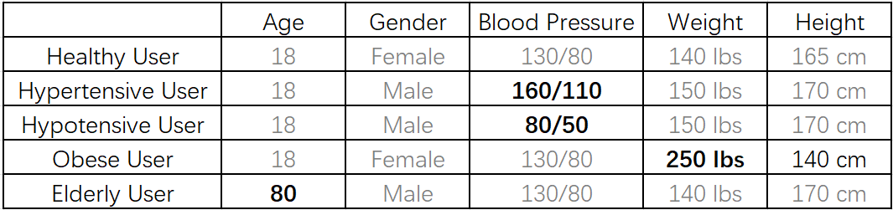
Testing
For life Advice, we tested five user profiles with different health conditions
The application provides specific and actionable recommendations based on each profile. For example, for male users with high blood pressure, the app recommends reducing sodium intake, eating more fruits and vegetables, and engaging in light exercise, such as swimming or yoga. It also correctly adjusts recommendations for users with low blood pressure, obesity, or the elderly.

Slide 15
Discussion
According to the previous test results, our software can be improved in the following two points
Strengthen personalized consultation: Currently, recommendations are based on a user's basic data, such as age, weight and blood pressure. While this approach works, we may be able to integrate more data points, such as activity levels, dietary preferences, and medical history. For example, users with a sedentary lifestyle can receive tailored exercise programs, while dietary recommendations can take into account allergies or cultural food preferences. This enhancement will make LLaMA's recommendations more specific.
Using better models: While the Q&A module can handle common questions, it is often difficult to answer some questions involving medicine and complex medical questions. In order to achieve this goal, we should probably search for better question and answer models, especially focusing on the medical field.
In addition to these improvements, real-time data collection in conjunction with wearable devices such as the apple watch is also a way to improve

Slide 16
Conclusion
In conclusion, ONTech Health Mobile successfully demonstrates the potential of integrating large language models into personalized health management. Our app enables users to store health information, receive tailored lifestyle advice, and access health consultations, addressing the need for portable and accessible health tools.
Our tests validated the app's ability to provide actionable recommendations and accurate answers in a variety of scenarios. With improvements, ONTech Health Mobile is expected to become a trusted proactive health management tool that Bridges the gap between advanced AI technologies and everyday healthcare.

Slide 17
Q & A

Slide 18
Thank You !

